Slide 1
Pre-Project Presentation Multiple Disease Prediction Model Programme: B.Tech in CSE Semester: 7
Mentor : Ms. Pallavi Kumar
Group No. : 06
Team Leader : Shubham Paul
Department : CSE

Slide 2
Project Team
Sl no. | Registration no. | Students
1. | 19ETCS002405 | Shubham Paul
2. | 19ETCS002109 | Sanath Kumar Shenoy
3. | 19ETCS002097 | Raina Dwivedi
4. | 19ETCS002100 | Rhea Hota

Slide 3
Outline
Title and Aim
Objectives
Methods and Methodology(Or Block Diagram)
Status of the Work
Results
Expected Outcomes
Cost Estimation
Gantt Chart
References

Slide 4
Title
MULTIPLE DISEASE PREDICTION MODEL

Slide 5
Aim
To develop a web page such that multiple diseases could be predicted conveniently and efficiently.

Slide 6
Objectives
To conduct a literature survey on existing disease prediction models.
To analyse our requirements for the project like ML models to be used, Tech-stack, various libraries and test data.
To design our system such that the user will feed some required data, based on which our model will predict.
To implement the model using the fed test data, such that any of the three diseases could be predicted. We use different ML Algorithms to test our data.
To analyse the test results of using different ML algorithms and predict their accuracy.
To document the work as a report containing all the specifics and technicalities.

Slide 7
Methods and Methodology /Block Diagram
Objective 1: To conduct a literature survey on existing disease prediction models.
1.1: Books, patents, published papers and other documents will be studied to get an idea about the existing disease prediction model.
1.2: Possible ML algorithms will also be listed.
1.3: Tech stack to work accurately on these models will also be studied.
1.4:Based on the literature survey, the requirements will be listed and analyzsed.

Slide 8
Objective 2:To analyse our requirements for the project like ML models to be used, Tech-stack, various libraries and test data.
2.1: We use Anaconda distribution and spider package to further load required libraries.
2.2: For the purpose of User-Interface we use Stream lit in Python.
2.3: We use three main libraries i.e Streamlit, Streamlit option menu and Pickle.

Slide 9
Objective 3:To design our system such that the user will feed some required data, based on which our model will predict.
3.1: Our system will be such that the user shall enter the required data, and our ML model on the basis of the test data and algorithm will predict whether the patient is suffering from a particular disease or not.

Slide 10
Objective 4:To implement the model using the fed test data, such that any of the three diseases could be predicted. We use different ML Algorithms to test our data.
4.1: We will require different types of input data to be inserted by the user for matching it with the test data, to predict the presence of disease.
4.2: We’re using Logistic Regression, Decision Tree and Boosting tree for prediction.
4.3: We will be able to predict if the person is Diabetic, has heart disease or has Parkinsons.

Slide 11
Objective 5:To analyse the test results of using different ML algorithms and predict their accuracy.
5.1: Different ML algorithms will predict the disease using the same test data.
5.2: But the accuracy of each algorithm will be different, which is graphed in the next slide.

Slide 12
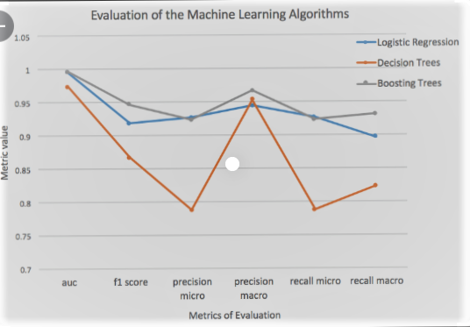

Slide 13
Objective 6: To document the work as a report containing all the specifics and technicalities 6.1: A project report will be authored documenting the entire development. 6.2: All requirements will be documented in SRS format. 6.3:Design diagrams will be included in the report. 6.4:Testing reports along with results will be documented. 6.5:The working of the system will be documented including screenshots, figures, tables etc. 6.5: The user survey and its analysis will be documented.

Slide 14
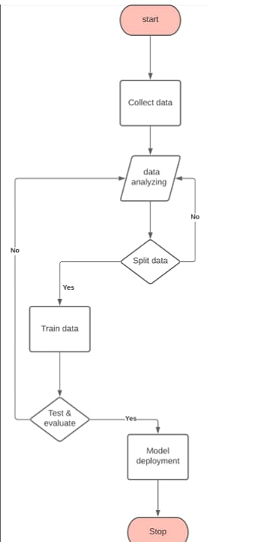
Design

Slide 15
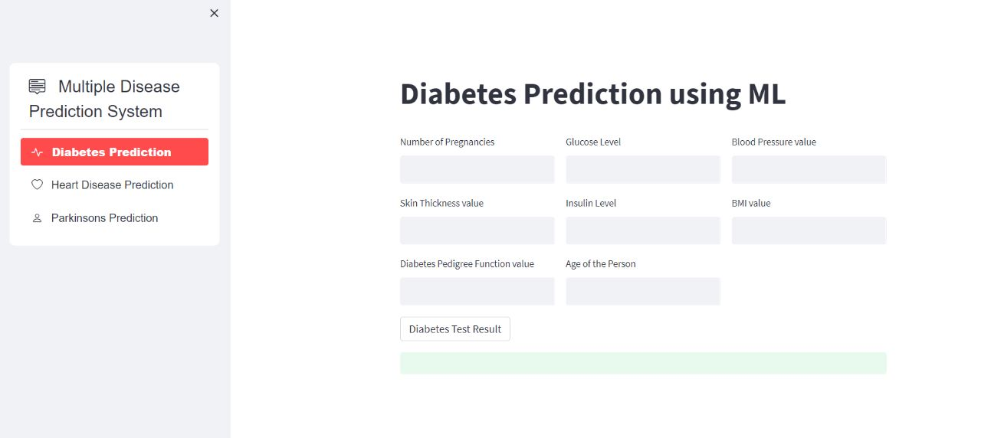
Status of the Work

Slide 16
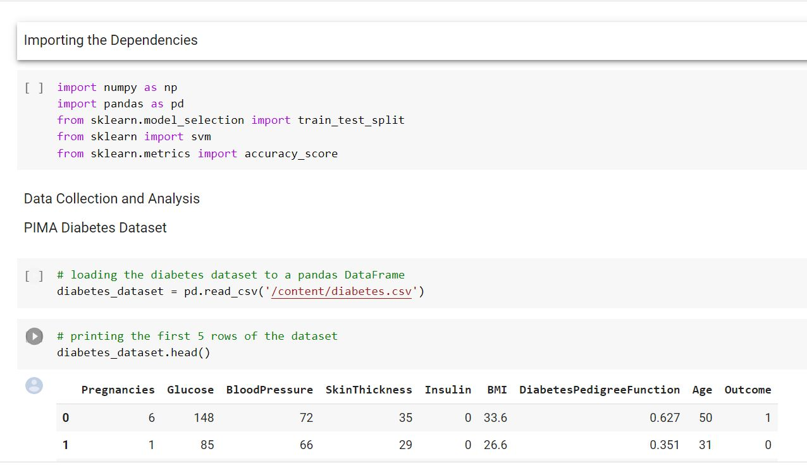
Status of the Work

Slide 17
RESULTS

Slide 18
Expected Outcomes
Demonstration of Working Model.
Product Tool.

Slide 19
Cost Estimation
S.NO. | COMPONENTS | QUANTITY | ESTIMATE COST
1 | SOFTWARE | 1 | 0
 |  | TOTAL: | 0
Man Hours:
Man hours per week(Students): 18 hrs *4 students=72 hrs
Man hour per week(faculty): 3

Slide 20
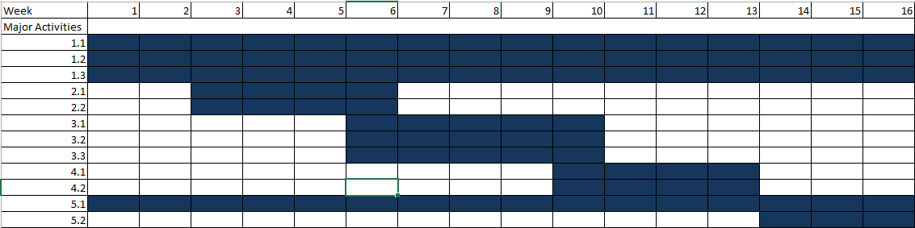
Gantt Chart

Slide 21
References
https://bmcmedinformdecismak.biomedcentral.com/articles/10.1186/s12911-019-1004-8
https://towardsdatascience.com/deploying-ml-models-using-streamlit-5d6212453bdd

Slide 22
THANK YOU

